Slide 1
Efficient Acoustic Modelling of Large Spaces Using Time Domain Methods
Simon Durbridge
Bowers & Wilkins
Adam Hill
Department of Electronics, Computing & Mathematics, College of Engineering & Technology, University of Derby
11/2017
Notes:
Good afternoon
My name
Welcome to my presentation on exploring efficient time domain methods for modelling large spaces

Slide 2
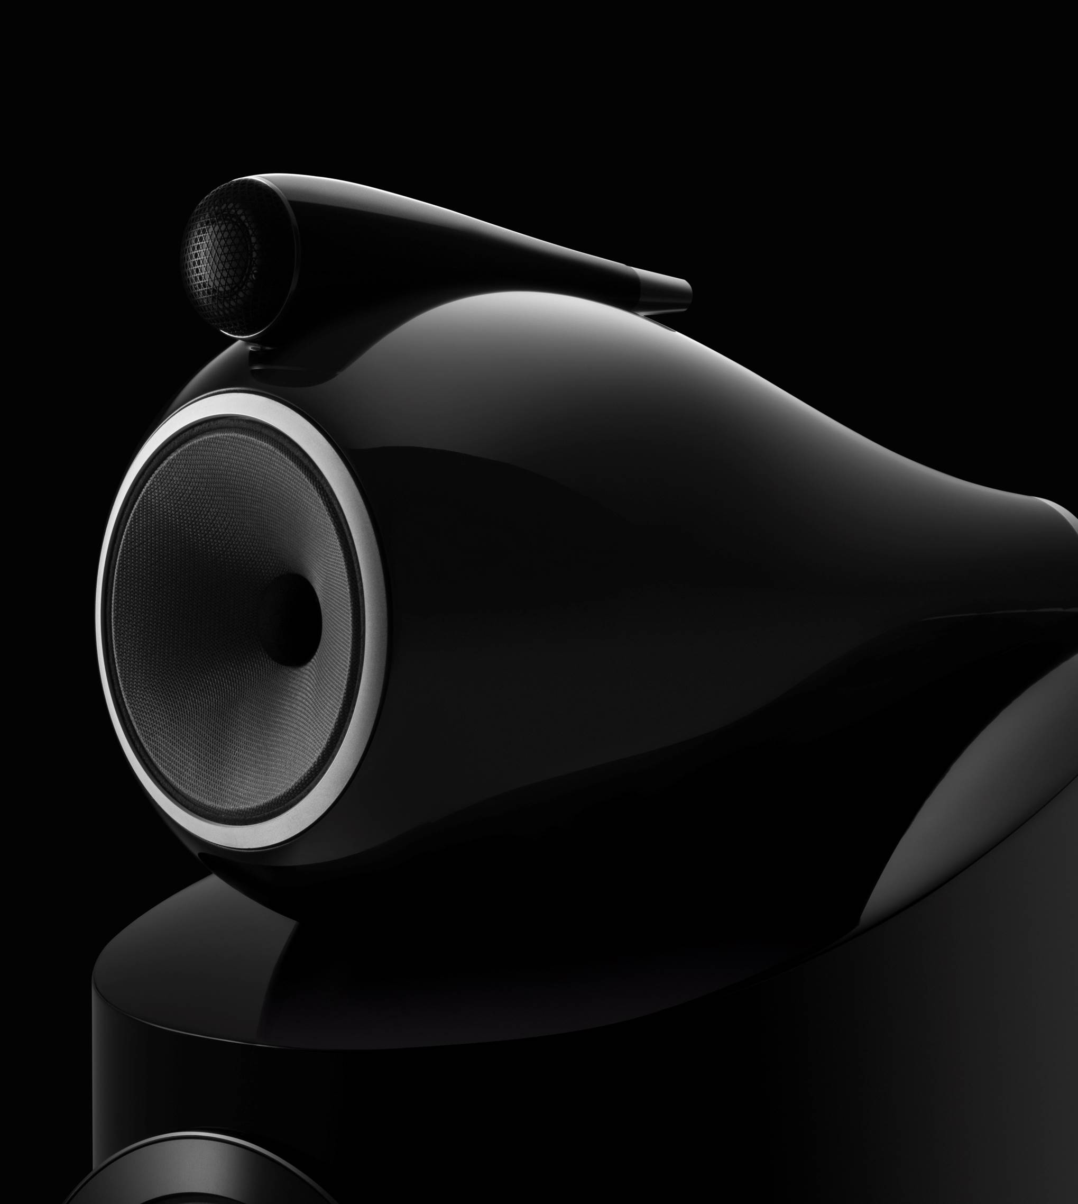
Contents
Background
Why can modelling large spaces be slow?
Methods that might improve simulation speed
Execution Speed Comparison
Conclusion
Notes:
I hope to share with you a few ideas and observations with regards to speeding up variants of finite difference methods.
I will go through the background of why the finite difference time domain method might be slow when simulating large spaces, and share some variants of the FDTD methods that might have potential to get faster results.
I will then share the results of a speed comparison between these methods, and end this presentation with a call for guidance.

Slide 3
Background
Why are we interested in modelling large spaces using time domain methods?
Notes:
First, let me introduce to you the motivation for the study

Slide 4
Background
Why Time Domain Methods?
Finite Difference Time Domain Method
Aim of The Work
Notes:
I will discuss why I am interested in time domain methods, I will introduce the basic concept of the three methods considered in this study, and outline the aim of the work I am presenting.

Slide 5
Why Time Domain Methods?
For low cost and rapid ‘prototyping’ of acoustic systems, tools should be:
Flexible
Simple
Intuitive
Scalable
Accurate
Notes:
Why time domain methods?
Why finite difference methods?
Why not frequency domain methods?
The Finite Element Method is mature (there is a lot of background research, and successful commercial product), and the Boundary Element Method can be very fast.
Tools for low cost and quick prototyping of acoustics systems should be easy to use, intuitive, scalable and accurate.
The finite difference time domain method fulfils much of this criteria in different ways to FEM and BEM, where simulations can be made in languages such as Matlab and Python; using libraries and code-bases that are easy to understand, change and modify for different purposes, without the need for CAD packages and traditional meshing tools.

Slide 6
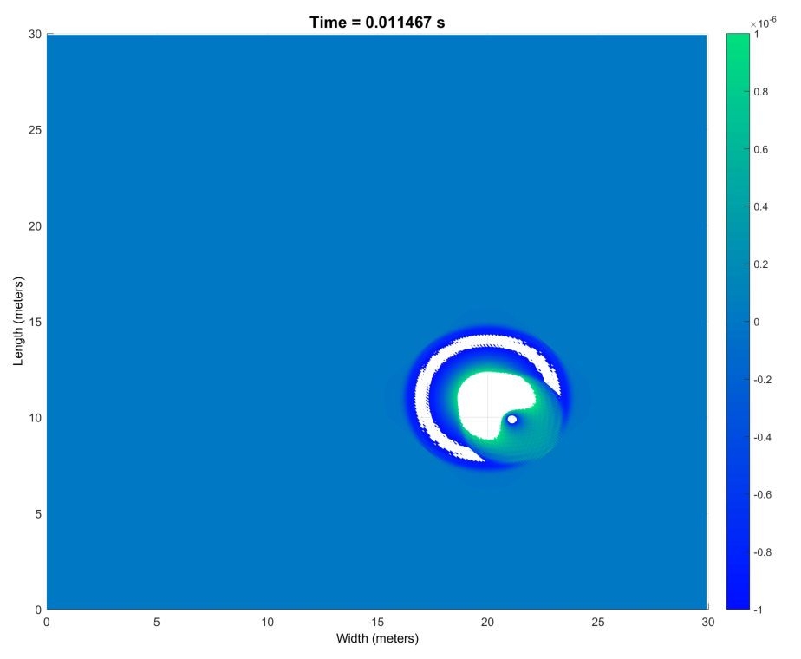

FDTD Simulation of Cardioid Sources
Notes:
It is possible to put together simple simulations to characterise different scenarios, like the effect of putting a cardioid subwoofer in a corner.
See how nulls are created due to the extra reflections.
Information like this could allow designers to consider different ideas and test them in software, before committing extra time and money to physically prototype systems.

Slide 7
Finite Difference Time Domain Method
Wave Equation Solving
Discretization of the domain as points
Solve each field of the domain in turn
Marching on in time
Simple implementation of partial absorbing boundaries
Implementation based on earlier work by Hill
A. J. Hill, “Analysis , Modelling and Wide-Area Spatiotemporal Control of Low-Frequency Sound Reproduction,” University of Essex, 2012.
Notes:
The finite difference time domain method is a numerical method for solving wave equations, and is popular in the field of computational electromagnetics from where it originates.
The FDTD and SFDTD code in the presented work, was built from the original work by one of the authors, Adam Hill.
The fluctuating sound field (the solution) is calculated by iteratively calculating pressure and velocity values across a discretized domain.
As shown in the graphic, the domain is split up into a series rectangles, the vertices of which is represent discrete points of velocity or pressure within the domain.
These points are realised as values within matrices that represent a field of values i.e. a matrix for pressure, a matrix for velocity in the x direction and so on.
The value for each point in the domain is calculated by using the nearest reciprocating field points. An individual pressure points value at the new step in time, is calculated using the pressure at the previous time step and the nearest velocity points in each dimension. The same is true for calculating velocity points, based on local pressures.

Slide 8
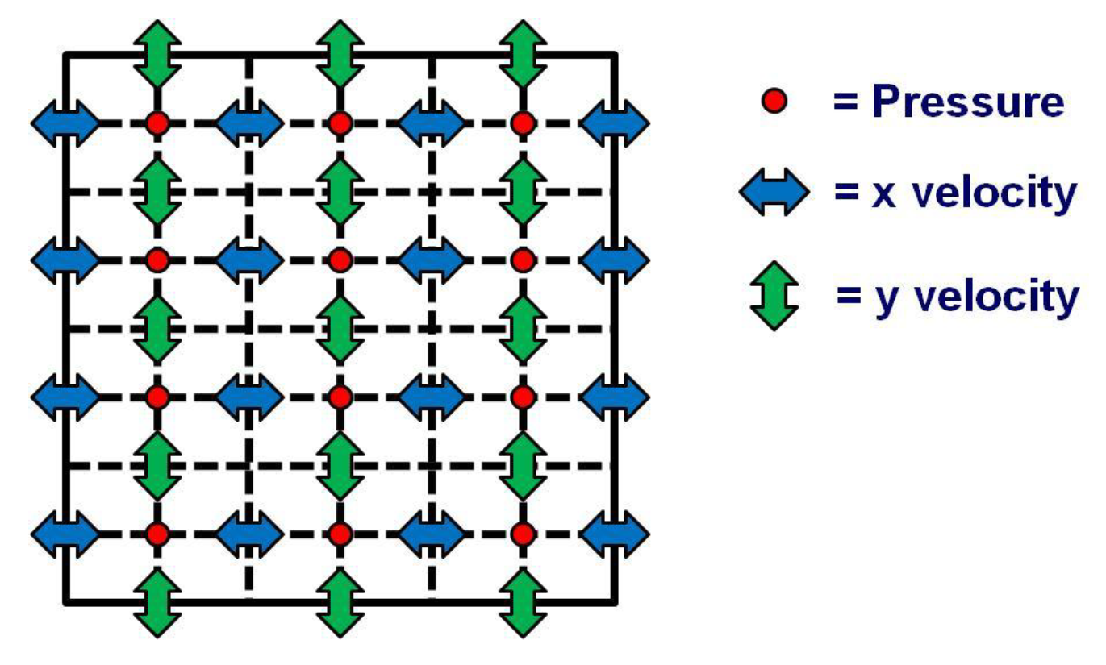
Finite Difference Time Domain Method
A. J. Hill, “Analysis , Modelling and Wide-Area Spatiotemporal Control of Low-Frequency Sound Reproduction,” University of Essex, 2012.
Notes:
The finite difference time domain method is a numerical method for solving wave equations, and is popular in the field of computational electromagnetics from where it originates.
The FDTD and SFDTD code in the presented work, was built from the original work by one of the authors, Adam Hill.
The fluctuating sound field (the solution) is calculated by iteratively calculating pressure and velocity values across a discretized domain.
As shown in the graphic, the domain is split up into a series rectangles, the vertices of which is represent discrete points of velocity or pressure within the domain.
These points are realised as values within matrices that represent a field of values i.e. a matrix for pressure, a matrix for velocity in the x direction and so on.
The value for each point in the domain is calculated by using the nearest reciprocating field points. An individual pressure points value at the new step in time, is calculated using the pressure at the previous time step and the nearest velocity points in each dimension. The same is true for calculating velocity points, based on local pressures.

Slide 9
Finite Difference Time Domain Method
$$∇ v$$
∇ 𝑣
$$∇ p$$
∇ 𝑝
Supporting Code
Notes:
The finite difference time domain method involves calculating the field values of pressure and velocity by marching on in time.
The time of the simulation is split up into time steps, that represent the passing of some amount of time within the simulation between computations.
Typically, each fields value is calculated for the current time, based on the condition of that fields value one time step ago, and the condition of the reciprocating field half a time step ago.
This overlapping of fields in time and space is a key characteristic of the FDTD method first described by Kane S Yee, for simulating electromagnetic problems in the 60s.
This discretization of time and space is a key feature that we will return to shortly.

Slide 10

Notes:
The problem with the finite difference time domain method is that (much like other numerical methods, BEM, FEM etc.) as the domain gets larger or the frequency of interest gets higher, the solution gets much slower.

Slide 11
Aim of The Work
EXPLORE METHODS FOR ACHIEVING FASTER SOLUTIONS
Notes:
So the aim of this work is to explore why modelling large domains is so slow, and look at to ways that might speed it up.

Slide 12
Why can modelling large spaces be slow?
What are the major causes of the FDTD method being slow?
Notes:
So, why are models of large domains so slow?

Slide 13
Why is modelling large spaces so slow?
Stability
Spatial Step
Time Step
Domain Size
Matrix Indexing
Notes:
There are a few key fundamentals to time marching solvers that could answer this question, but I am going to discuss what I consider to be the most fundamental problems.
These are based on the conditions for stability.
I will also briefly discuss some of the practicalities of matrix indexing.

Slide 14
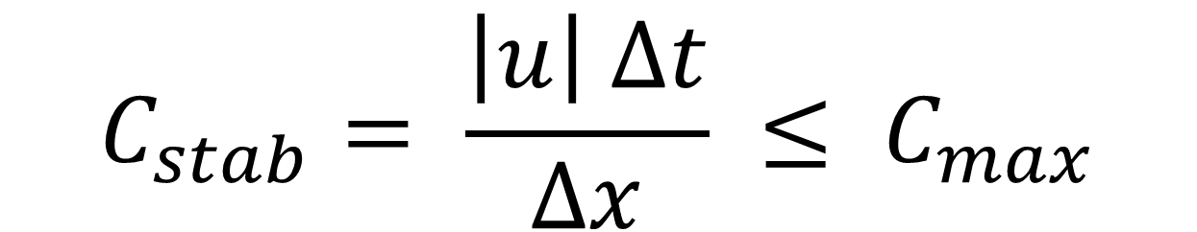
Stability
$$C_{stab}= \frac{\left|u\right| ∆t}{∆x} ≤ C_{max}$$
Courant-Fredrichs-Lewey Condition
K. Kunz and R. Luebbers, “The Finite Difference Time Domain Method for Electromagnetics.” p. 464, 1993.
Notes:
Time stepping numerical methods are bounded by many conditions for a stable, convergent solution.
One of these conditions that must be satisfied but does NOT guarantee a convergent stable solution is the CFL condition.
This condition states that the time step must scale with and be within an absolute maximum, based on the wave speed and spatial step size of a simulation.
The spatial step size is determined by the minimum frequency and stability of the simulation and solving methods, and many sources referenced in the conference paper suggest that between 6 and 10 points per wavelength is required for a reasonable FDTD solution.
For a generic second order explicit FDTD scheme stepping through time, Cmax is often 1.0.
Time step and spatial step are going to largely determine how long it takes to solve a simulation, as the number of slices in space increases the number amount of arithmetic operations required per time step increases; and as the number of slices in time increases the number total operations required to realise the outcome of a simulation increases. It always takes an amount of time for some useful information to come from a simulation, as no single sample is meaningful or consequent on its own.

Slide 15
Spatial Step
As frequency increases, problem size increases
Notes:
As the problem size scales inversely with wavelength, if we wish to simulate a large domain such as a 60 x 40 x 30 meter rectangular arena up to 10kHz, the pressure and each velocity matrix will have nearly 5 Trillion points (shortscale).

Slide 16
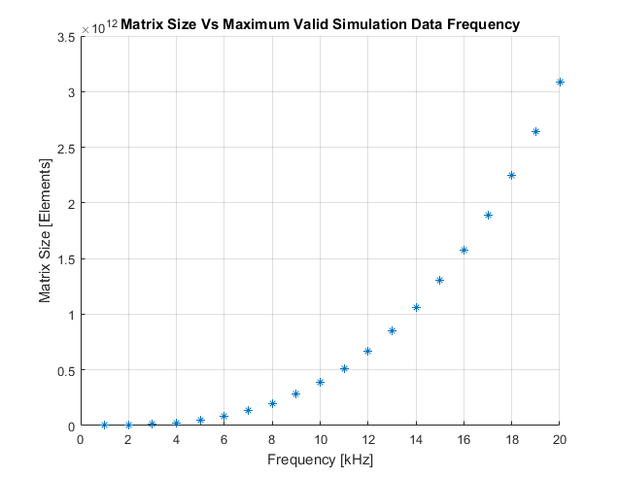
Matrix size Vs maximum simulation frequency for 60 x 40 x 30 meter rectangle [best case geometry]
Notes:
As the problem size scales inversely with wavelength, if we wish to simulate a large domain such as a 60 x 40 x 30 meter rectangular arena up to 10kHz, the pressure and each velocity matrix will have nearly 5 Trillion points (shortscale).
We can see that for large domains, high frequency simulation is going to be difficult with regards to memory access, but that is only half the CFL condition story.
We should also consider the time step.

Slide 17
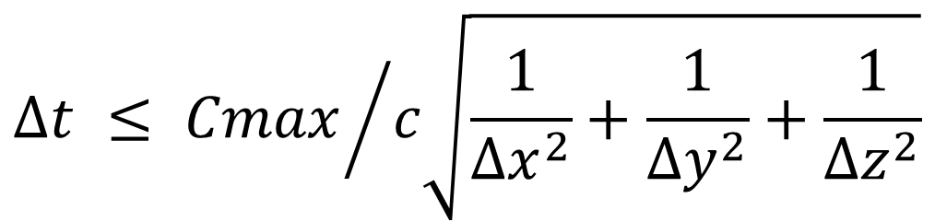
Time Step
$$Δt ≤ {Cmax}/{c\sqrt{\frac{1}{{∆x}^{2}}+\frac{1}{{∆y}^{2}}+\frac{1}{{∆z}^{2}}}}$$
As spatial step decreases, time step must also decrease
A. J. Hill, “Analysis , Modelling and Wide-Area Spatiotemporal Control of Low-Frequency Sound Reproduction,” University of Essex, 2012.
Notes:
As frequency goes up, the number of time steps required per unit time goes up, regardless of the size of domain.
The equation shown here is derived from the CFL equation, and suggests that as the speed of sound c increases, or the spatial step delta x (y z) decreases, the maximum time step required to fulfil the CFL condition decreases.
As the number of time steps per unit time increases, the number of iterations over the simulation time inherently increases and the time taken to solve the simulation increases.

Slide 18
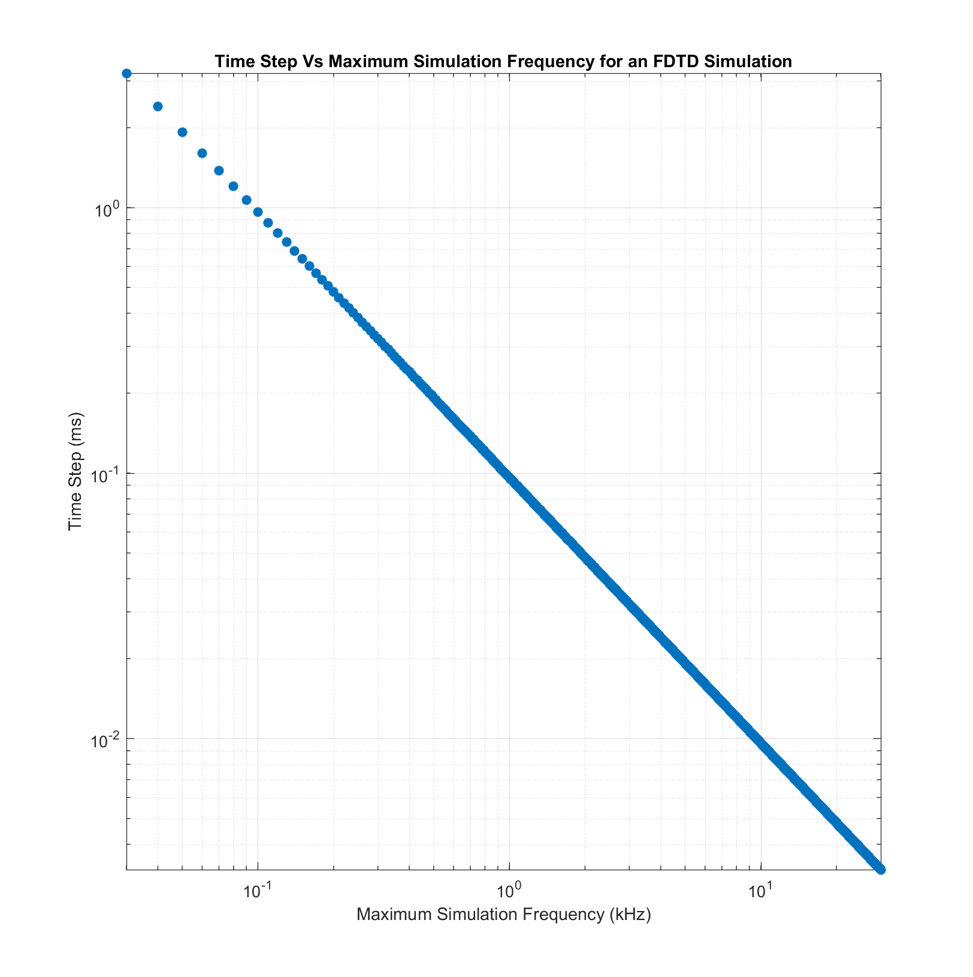
Notes:
As frequency goes up, the number of time steps required per unit time goes up, regardless of the size of domain.
The equation shown here is derived from the CFL equation, and suggests that as the speed of sound c increases, or the spatial step delta x (y z) decreases, the maximum time step required to fulfil the CFL condition decreases.
As the number of time steps per unit time increases, the number of iterations over the simulation time inherently increases and the time taken to solve the simulation increases.

Slide 19
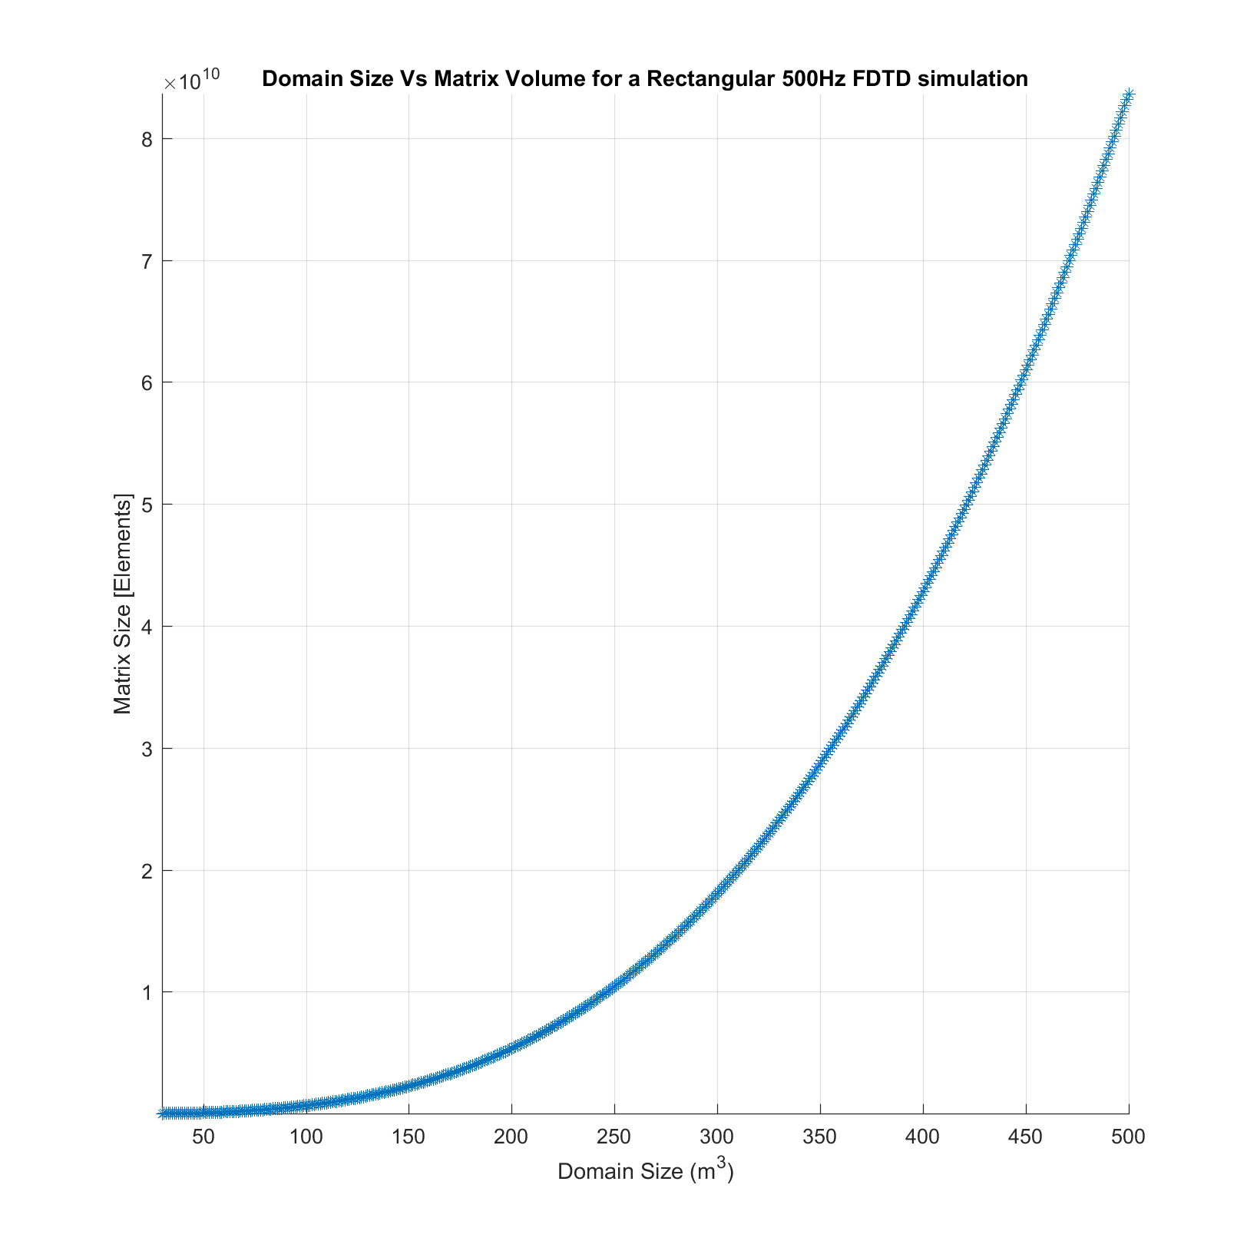
Domain Size
As domain dimensions increase linearly, the number of cells increases exponentially
Notes:
As the size of the dimensions to be modelled increase, the volume of the computational domain increases at an exponential rate.
The volume of a cube increases exponentially, relative to the increase of the length the edges.
[ Change Slide ]

Slide 20

Domain Size
As domain dimensions increase linearly, the number of cells increases exponentially
Notes:
The more fundamental problem here is that we have to deal with large constructs of memory, which means we need a large amount of memory available and hardware needs to be able to work with large amount of memory quickly. This is not a trivial problem to solve, very much so when considering the limitations of generally available hardware.
[PLOT ASSUMES DOUBLE PRECISION FLOATING POINT]

Slide 21
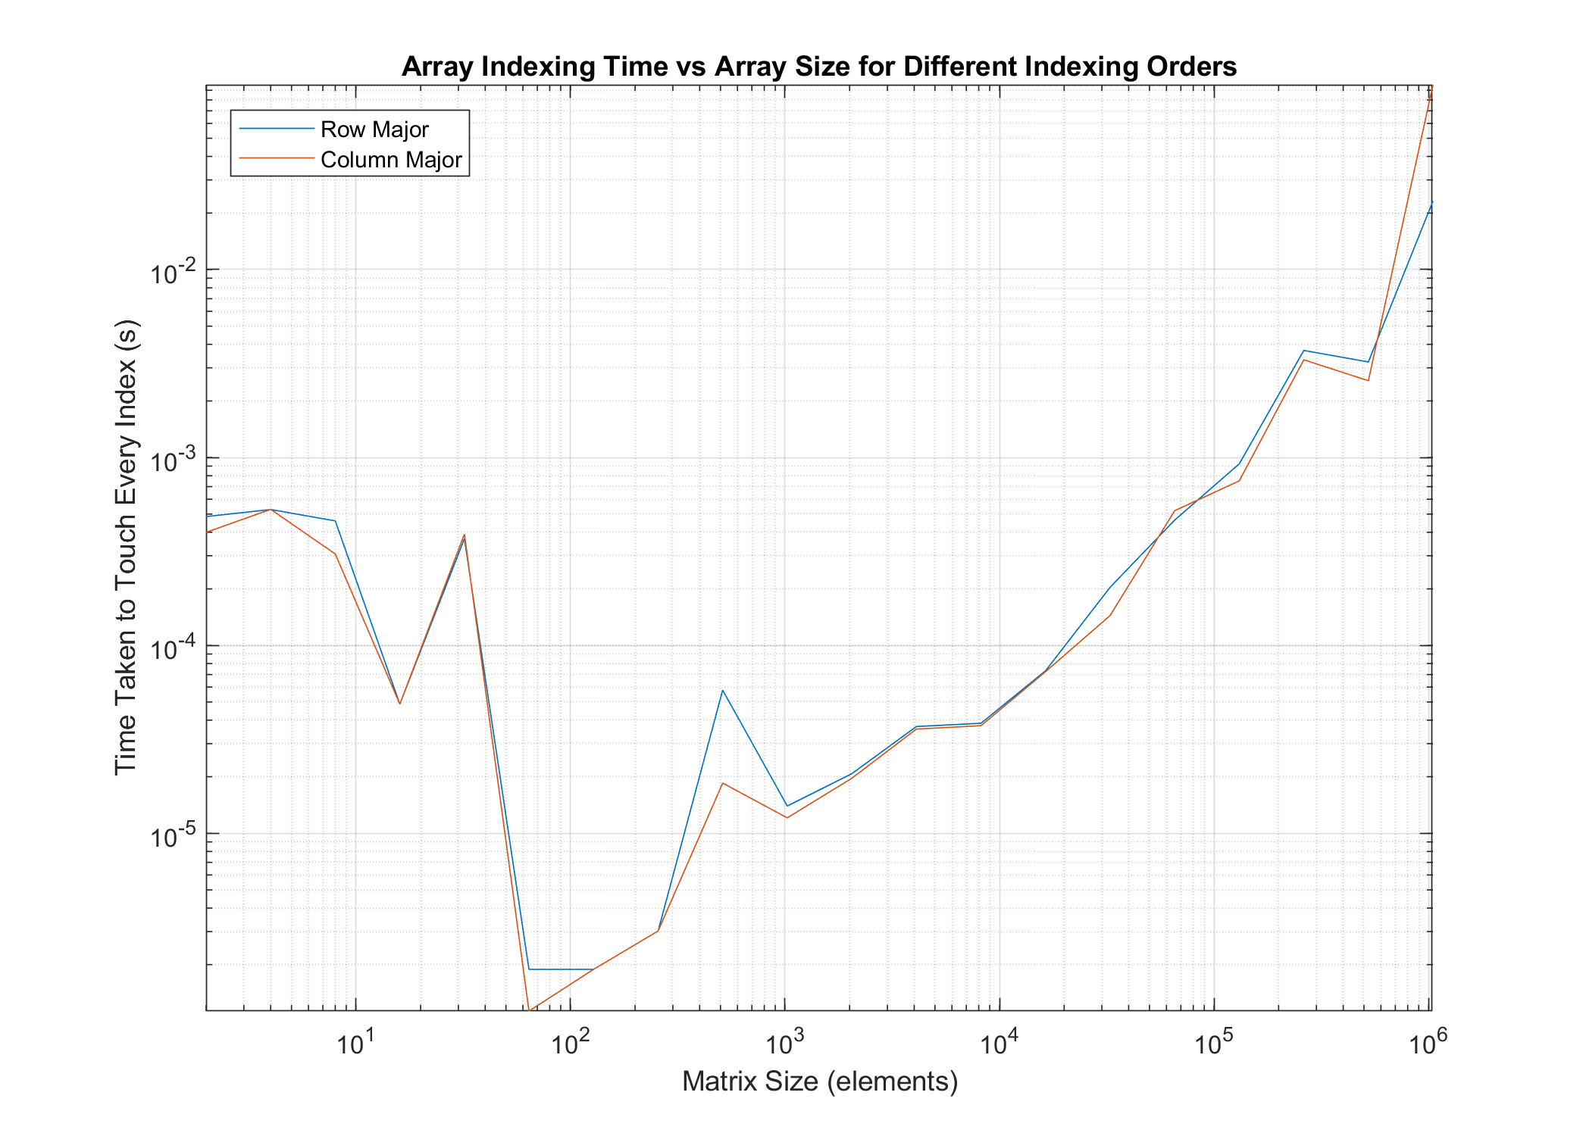
Matrix Indexing
System optimised for contiguous memory indexing
Memory is accessed in cache sizes
Indexing into matrix vertically becomes slower as matrix gets bigger
https://www.youtube.com/watch?v=BP6NxVxDQIs
Notes:
If using video, fast forward start to 7 mins

Slide 22
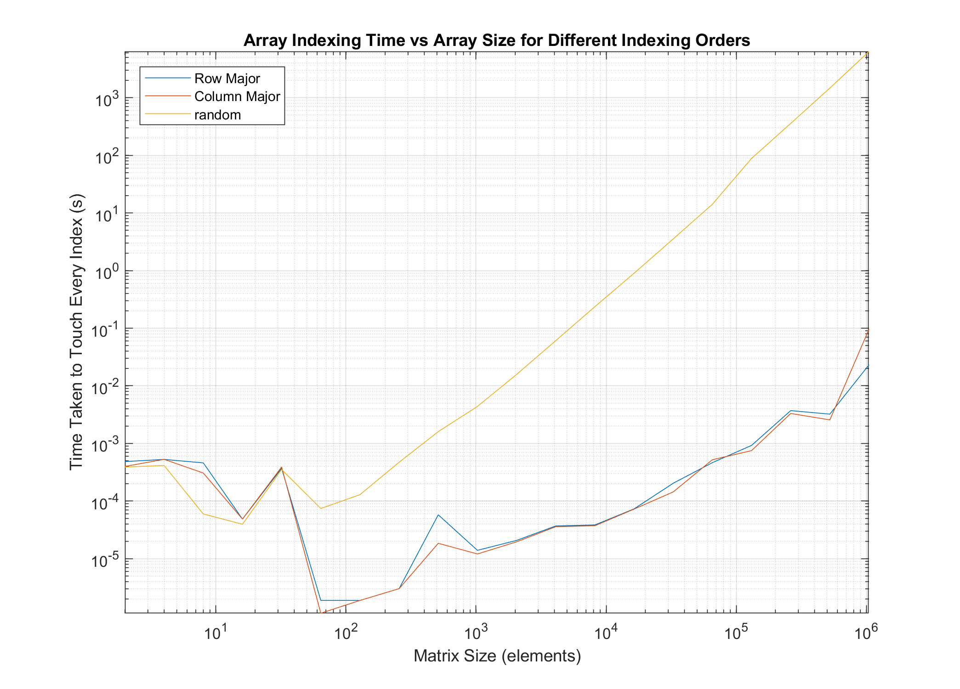
Matrix Indexing
System optimised for contiguous memory indexing
Memory is accessed in cache sizes
Indexing into matrix vertically becomes slower as matrix gets bigger
https://www.youtube.com/watch?v=BP6NxVxDQIs
Notes:
If using video, fast forward start to 7 mins

Slide 23
Methods that might improve speed
Introducing PSTD and SFDTD
Notes:
So we can see that we want to either reduce or optimise the memory accesses we do, and if we can reduce total amount of memory required, great.
Two potential variants of the FDTD method that could do this are the pseudospectral time domain method, and the spare finite difference time domain method.

Slide 24
Pseudospectral Time Domain Method
Fourier PSTD
Differentiation performed in frequency domain
Frequency domain field is multiplied with complex impulse response of ideal differentiator
Bounded by a perfectly matched layer (PML)
Implementation based on work by Angus & Caunce
Notes:
The Fourier pseudospectral time domain method is similar to the FDTD method, calculating a time domain solution to a sound field in a leap-frog time marching way.
However, differentiation is performed in the frequency domain.
Each time-step, each dimension of the domain is transformed in the frequency domain using the fast Fourier transform.
The frequency domain representation is then differentiated, by multiplying with the complex form of an ideal differentiator.
The reciprocating fields are then calculated using these differentiated fields, in the same leapfrog way as FDTD.
To mitigate the Gibbs phenomenon, the boundary of the domain must seem continuous and infinitely large.
A perfectly matched layer is used to accommodate for this behaviour.
A perfectly matched layer is a portion of the medium where a series of coefficients allow for the transit of waves from any direction to enter the portion and decay without leaving.
The PSTD work presented here is an extension of the work by Angus & Caunce, A GPGPU Approach to Improved Acoustic
Finite Difference Time Domain Calculations
The reason this might be faster than the FDTD method is two fold. First of all we are indexing entire portions of arrays, that can be nicely vectorised and sped up.
We can use optimised libraries like FFTW to get higher performance than having to do local memory accesses, and hoping enough of our required memory remains in the cache.
Also, because of the stability and accuracy of PSTD methods, the time step (number of executions per unit time) and spatial step (matrix size) is smaller than FDTD for the same problem.
The down side is the difficult of modelling discontinuities, and numerical dispersion can be quite apparent if you struggle to get the properties of the simulation correct.

Slide 25
Pseudospectral Time Domain Method
A. J. Hill, “Analysis , Modelling and Wide-Area Spatiotemporal Control of Low-Frequency Sound Reproduction,” University of Essex, 2012.

Slide 26
Pseudospectral Time Domain Method
FFT matrix in n dimension
Multiply by differentiator
IFFT
Compute reciprocal field
PML coefficients applied to cells within boundary
Add source term
AOB
Notes:
The Fourier pseudospectral time domain method is similar to the FDTD method, calculating a time domain solution to a sound field in a leap-frog time marching way.
However, differentiation is performed in the frequency domain.
Each time-step, each dimension of the domain is transformed in the frequency domain using the fast Fourier transform.
The frequency domain representation is then differentiated, by multiplying with the complex form of an ideal differentiator.
The reciprocating fields are then calculated using these differentiated fields, in the same leapfrog way as FDTD.
To mitigate the Gibbs phenomenon, the boundary of the domain must seem continuous and infinitely large.
A perfectly matched layer is used to accommodate for this behaviour.
A perfectly matched layer is a portion of the medium where a series of coefficients allow for the transit of waves from any direction to enter the portion and decay without leaving.
The PSTD work presented here is an extension of the work by Angus & Caunce, A GPGPU Approach to Improved Acoustic
Finite Difference Time Domain Calculations
The reason this might be faster than the FDTD method is two fold. First of all we are indexing entire portions of arrays, that can be nicely vectorised and sped up.
We can use optimised libraries like FFTW to get higher performance than having to do local memory accesses, and hoping enough of our required memory remains in the cache.
Also, because of the stability and accuracy of PSTD methods, the time step (number of executions per unit time) and spatial step (matrix size) is smaller than FDTD for the same problem.
The down side is the difficult of modelling discontinuities, and numerical dispersion can be quite apparent if you struggle to get the properties of the simulation correct.

Slide 27
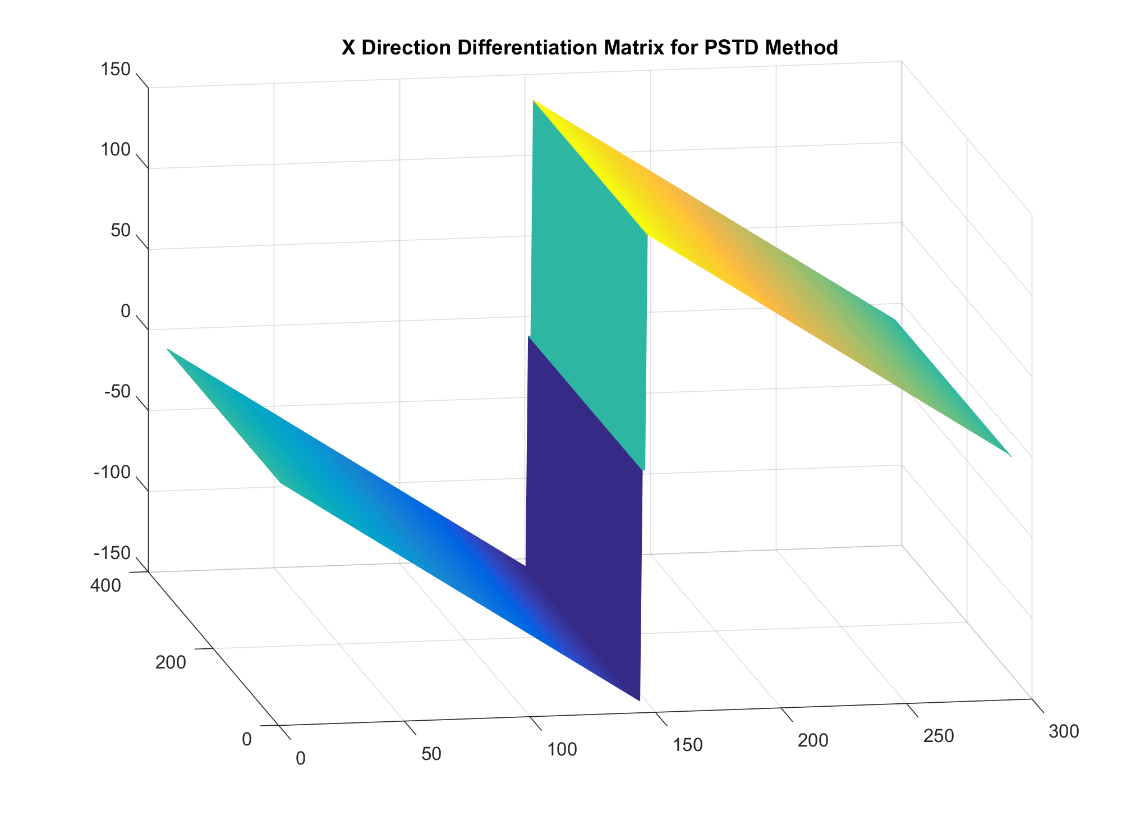
Pseudospectral Time Domain Method
S. Durbridge, “Efficient Acoustic Modelling of Large Spaces using Time Domain Methods Acoustic Modelling Applications,” pp. 1–8, 2017..
Notes:
The Fourier pseudospectral time domain method is similar to the FDTD method, calculating a time domain solution to a sound field in a leap-frog time marching way.
However, differentiation is performed in the frequency domain.
Each time-step, each dimension of the domain is transformed in the frequency domain using the fast Fourier transform.
The frequency domain representation is then differentiated, by multiplying with the complex form of an ideal differentiator.
The reciprocating fields are then calculated using these differentiated fields, in the same leapfrog way as FDTD.
To mitigate the Gibbs phenomenon, the boundary of the domain must seem continuous and infinitely large.
A perfectly matched layer is used to accommodate for this behaviour.
A perfectly matched layer is a portion of the medium where a series of coefficients allow for the transit of waves from any direction to enter the portion and decay without leaving.
The PSTD work presented here is an extension of the work by Angus & Caunce, A GPGPU Approach to Improved Acoustic
Finite Difference Time Domain Calculations
The reason this might be faster than the FDTD method is two fold. First of all we are indexing entire portions of arrays, that can be nicely vectorised and sped up.
We can use optimised libraries like FFTW to get higher performance than having to do local memory accesses, and hoping enough of our required memory remains in the cache.
Also, because of the stability and accuracy of PSTD methods, the time step (number of executions per unit time) and spatial step (matrix size) is smaller than FDTD for the same problem.
The down side is the difficult of modelling discontinuities, and numerical dispersion can be quite apparent if you struggle to get the properties of the simulation correct.

Slide 28
Pseudospectral Time Domain Method
Differentiation across a contiguous vector of points at one time
Potentially easier to leverage optimised libraries and SIMD if doing a C++ implementation
Higher order of accuracy (may require fewer points per wavelength for stable and accurate simulation)
Notes:
The Fourier pseudospectral time domain method is similar to the FDTD method, calculating a time domain solution to a sound field in a leap-frog time marching way.
However, differentiation is performed in the frequency domain.
Each time-step, each dimension of the domain is transformed in the frequency domain using the fast Fourier transform.
The frequency domain representation is then differentiated, by multiplying with the complex form of an ideal differentiator.
The reciprocating fields are then calculated using these differentiated fields, in the same leapfrog way as FDTD.
To mitigate the Gibbs phenomenon, the boundary of the domain must seem continuous and infinitely large.
A perfectly matched layer is used to accommodate for this behaviour.
A perfectly matched layer is a portion of the medium where a series of coefficients allow for the transit of waves from any direction to enter the portion and decay without leaving.
The PSTD work presented here is an extension of the work by Angus & Caunce, A GPGPU Approach to Improved Acoustic
Finite Difference Time Domain Calculations
The reason this might be faster than the FDTD method is two fold. First of all we are indexing entire portions of arrays, that can be nicely vectorised and sped up.
We can use optimised libraries like FFTW to get higher performance than having to do local memory accesses, and hoping enough of our required memory remains in the cache.
Also, because of the stability and accuracy of PSTD methods, the time step (number of executions per unit time) and spatial step (matrix size) is smaller than FDTD for the same problem.
The down side is the difficult of modelling discontinuities, and numerical dispersion can be quite apparent if you struggle to get the properties of the simulation correct.

Slide 29
Sparse FDTD
An extension of FDTD
Window used to determine domain to be computed
Normalise copy of pressure field
Smoothed window to include surrounding points
Implementation based on work by Doerr
Notes:
The sparse finite difference time domain method is an extension of the FDTD method, using a window to reduce the total number of computations performed per time step in a best case scenario i.e. discrete travelling wave fronts with minimal dispersion.
[BLACKOUT]
This isn’t the formulation of SFDTD I dreamed of when I started this work. I wanted to do a clever sliding mesh composition, sliding thin arrays around the problem to capture wave propagation with just row vectors.
Maybe someone on a PHd somewhere can make it happen.
[UNBLACKOUT]
The aim of this SFDTD implementation is to reduce the amount of the domain being computed when possible, by creating a window around portions of the domain containing an appropriate amount of energy.
A window is created by normalising pressure in the domain, around a threshold pressure.
This window is then smoothed using a Gaussian filter to include areas surrounding high pressure portions of the domain.
When simple discrete wave fronts are traveling across the domain, if numerical dispersion is low, the local differentiation that is needed is performed, and hopefully the total number of computations is reduced.
This relies on the compiler to be smart enough to do the array math for the window in an optimal way using vectorization, and much more work has to be done to optimize the whole process.

Slide 30
Sparse FDTD
Normalise domain around threshold
Floor/Ceil
Smooth using Gaussian filter
Floor/Ceil
Computer FDTD
Index of computation based on IF statement
Notes:
The sparse finite difference time domain method is an extension of the FDTD method, using a window to reduce the total number of computations performed per time step in a best case scenario i.e. discrete travelling wave fronts with minimal dispersion.
[BLACKOUT]
This isn’t the formulation of SFDTD I dreamed of when I started this work. I wanted to do a clever sliding mesh composition, sliding thin arrays around the problem to capture wave propagation with just row vectors.
Maybe someone on a PHd somewhere can make it happen.
[UNBLACKOUT]
The aim of this SFDTD implementation is to reduce the amount of the domain being computed when possible, by creating a window around portions of the domain containing an appropriate amount of energy.
A window is created by normalising pressure in the domain, around a threshold pressure.
This window is then smoothed using a Gaussian filter to include areas surrounding high pressure portions of the domain.
When simple discrete wave fronts are traveling across the domain, if numerical dispersion is low, the local differentiation that is needed is performed, and hopefully the total number of computations is reduced.
This relies on the compiler to be smart enough to do the array math for the window in an optimal way using vectorization, and much more work has to be done to optimize the whole process.

Slide 31
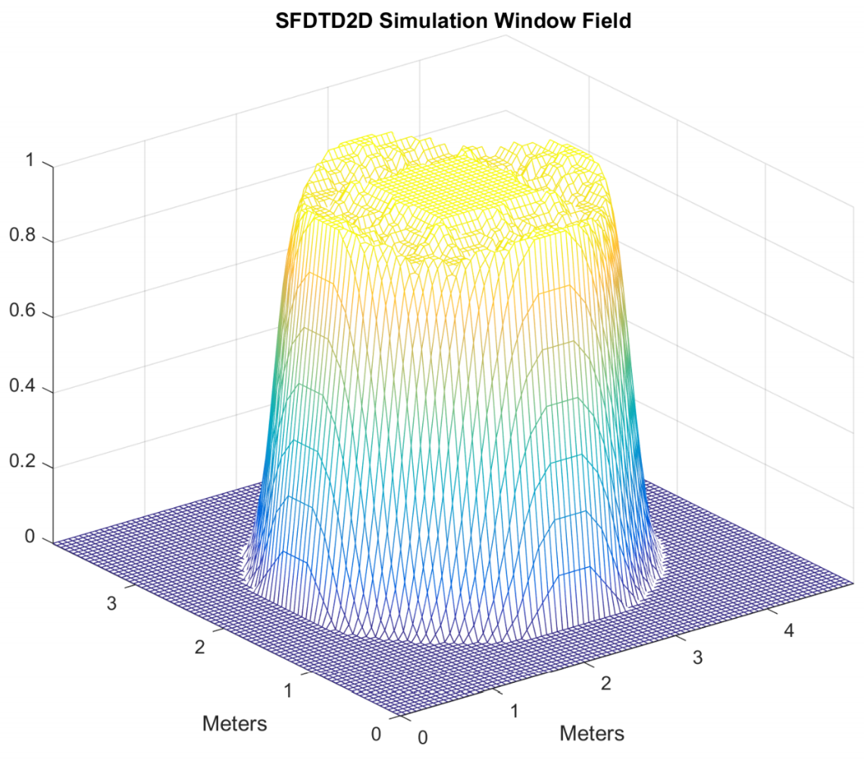
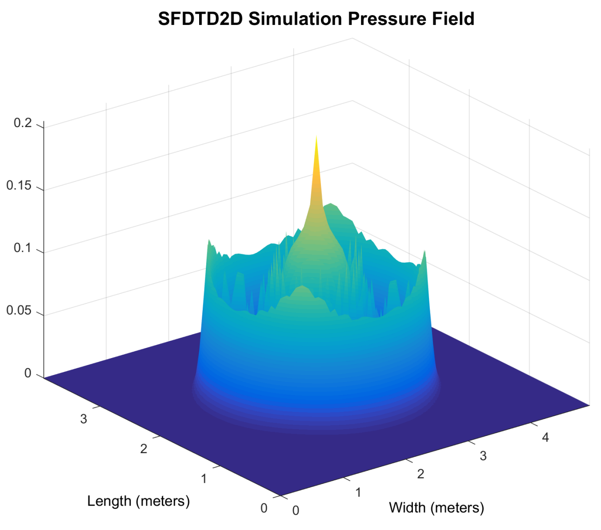
S. Durbridge, “Efficient Acoustic Modelling of Large Spaces using Time Domain Methods Acoustic Modelling Applications,” pp. 1–8, 2017..
Notes:
The sparse finite difference time domain method is an extension of the FDTD method, using a window to reduce the total number of computations performed per time step in a best case scenario i.e. discrete travelling wave fronts with minimal dispersion.
[BLACKOUT]
This isn’t the formulation of SFDTD I dreamed of when I started this work. I wanted to do a clever sliding mesh composition, sliding thin arrays around the problem to capture wave propagation with just row vectors.
Maybe someone on a PHd somewhere can make it happen.
[UNBLACKOUT]
The aim of this SFDTD implementation is to reduce the amount of the domain being computed when possible, by creating a window around portions of the domain containing an appropriate amount of energy.
A window is created by normalising pressure in the domain, around a threshold pressure.
This window is then smoothed using a Gaussian filter to include areas surrounding high pressure portions of the domain.
When simple discrete wave fronts are traveling across the domain, if numerical dispersion is low, the local differentiation that is needed is performed, and hopefully the total number of computations is reduced.
This relies on the compiler to be smart enough to do the array math for the window in an optimal way using vectorization, and much more work has to be done to optimize the whole process.

Slide 32
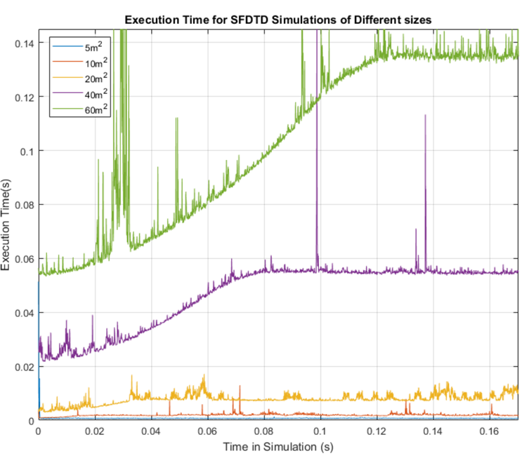
S. Durbridge, “Efficient Acoustic Modelling of Large Spaces using Time Domain Methods Acoustic Modelling Applications,” pp. 1–8, 2017..
Notes:
The sparse finite difference time domain method is an extension of the FDTD method, using a window to reduce the total number of computations performed per time step in a best case scenario i.e. discrete travelling wave fronts with minimal dispersion.
The aim of this SFDTD implementation is to reduce the amount of the domain being computed when possible, by creating a window around portions of the domain containing an appropriate amount of energy.
A window is created by normalising pressure in the domain, around a threshold pressure.
This window is then smoothed using a Gaussian filter to include areas surrounding high pressure portions of the domain.
When simple discrete wave fronts are traveling across the domain, if numerical dispersion is low, the local differentiation that is needed is performed, and hopefully the total number of computations is reduced.
This relies on the compiler to be smart enough to do the array math for the window in an optimal way using vectorization, and much more work has to be done to optimize the whole process.

Slide 33
Execution Speed Comparison
Are these methods any faster?
Notes:
So, are these methods any faster?

Slide 34
Contents
Experiment Setup
Validation
Results

Slide 35
Experiment Setup
PC Setup
Operating System: Windows 10
CPU: i5 4960k Overclocked to 4.3GHz and 1.227V
RAM: 16GB DDR3 ram at 3875 MHz
Motherboard: Asus Gryphon Armour Edition with Z97 chipset
GPU: Nvidia GTX 1070
S. Durbridge, “Efficient Acoustic Modelling of Large Spaces using Time Domain Methods Acoustic Modelling Applications,” pp. 1–8, 2017..
Notes:
I have a PC set up on easily accessible, relatively old but still good components.

Slide 36
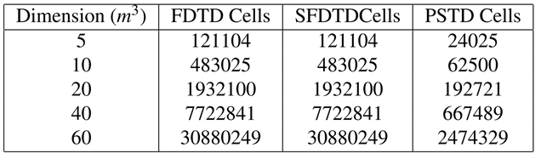
Experiment Setup
Time Steps: 2000
Maximum Frequency: 500Hz
Domain Sizes:
S. Durbridge, “Efficient Acoustic Modelling of Large Spaces using Time Domain Methods Acoustic Modelling Applications,” pp. 1–8, 2017..
Notes:
I set up three sets of experiments with different domain sizes. The sizes were chosen based on finding the largest domain I could fit into memory, and then reducing the size by a third, a half, a half and a half again. I ran each of these simulations for the same number of ‘in simulation’ time steps (2000), and at the same maximum frequency of 500Hz.

Slide 37
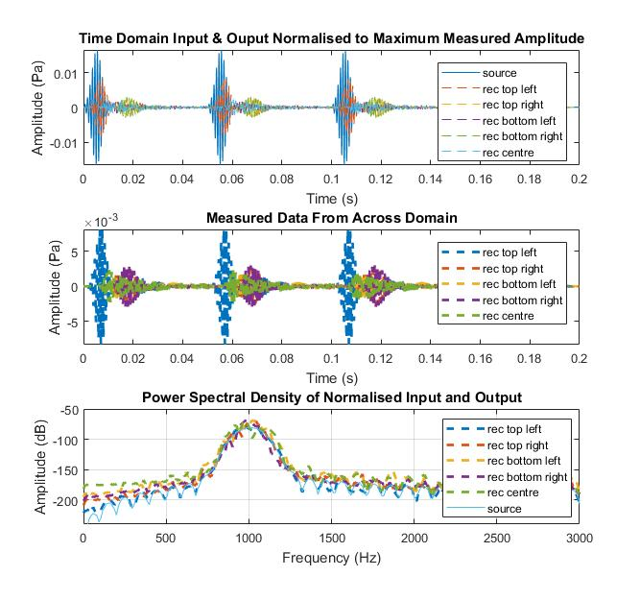
Validation
FDTD

Slide 38
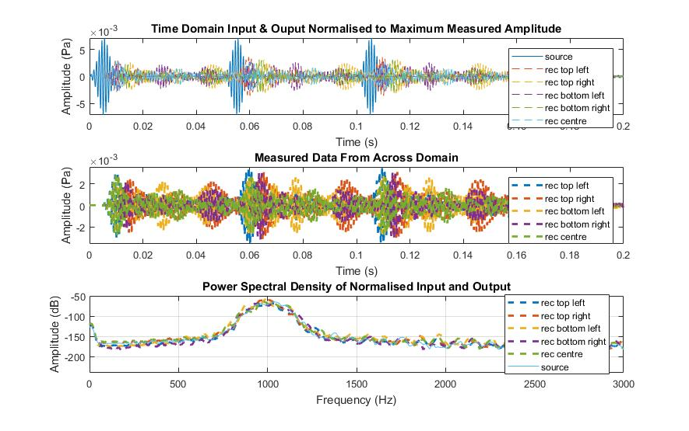
Validation
SFDTD

Slide 39
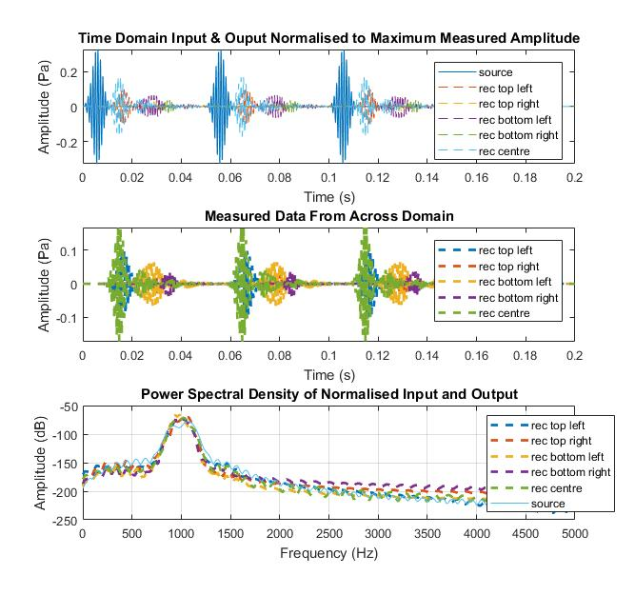
Validation
PSTD

Slide 40
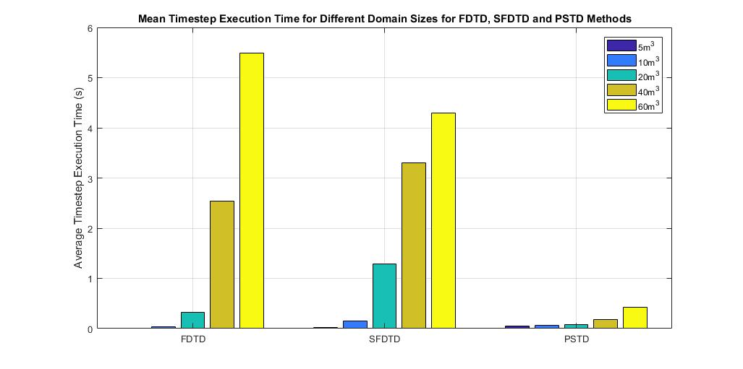
Results

Slide 41
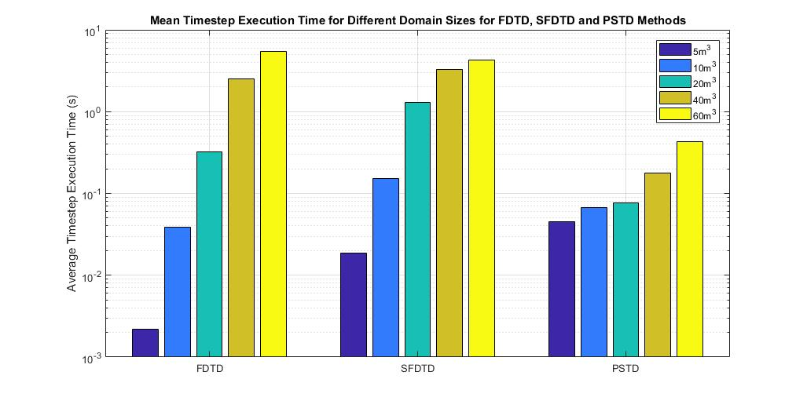
Results

Slide 42
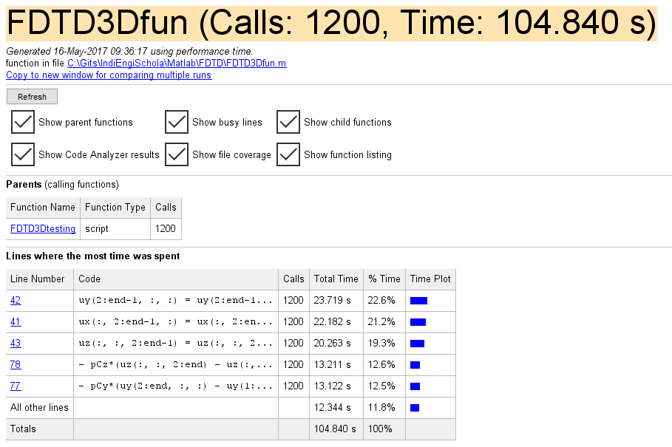
Profile

Slide 43
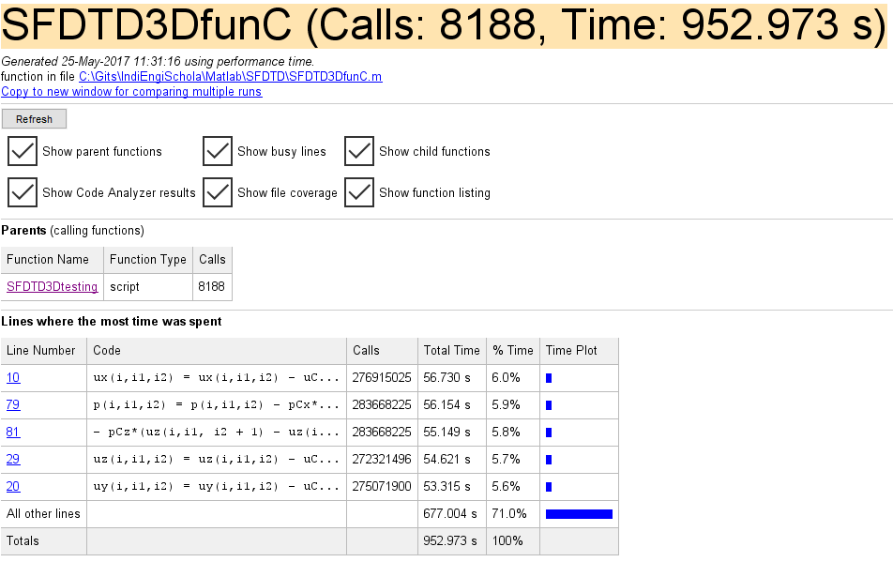
Profile

Slide 44
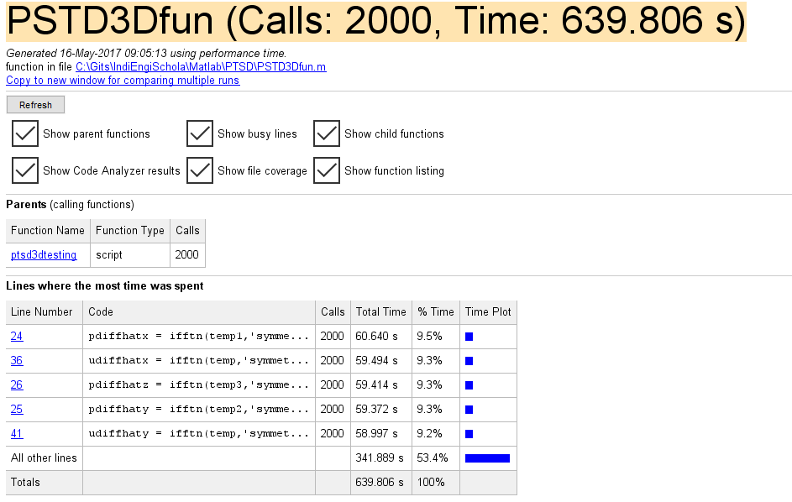
Profile

Slide 45
Conclusion
Closing Remarks

Slide 46
Outcomes
PSTD may be faster for large domains than FDTD and SFDTD, but may be less flexible for handling obstacles
SFDTD is generally very slow and requires a lot of work, but there may be potential to improve this method
The chief problem for execution speed appears to be memory access
PSTD may work well because the memory requirements are less than FDTD and SFDTD
PSTD may also benefit greatly from vectorisation, where FDTD and SFDTD may be more difficult to optimise

Slide 47
Further Work
Implement a flexible FDTD tool in C++ with JUCE
Experiment with hybrid FDTD/PSTD formulation to improve speed where possible, while handling discontinuities
Work to improve the methodology of SFDTD
Optimise windowing method
Filter shapes
Threshold
Improve indexing method
Implement in faster languages

Slide 48
A Request for Guidance
simon.durbridge@bowerswilkins.com
Notes:
I wanted to use this presentation as an opportunity to present some ideas. I recognise that the work presented here is very basic, but I think work on this kind of software could really help people get to grips with understanding sound. So if anyone is interested in this topic, I would welcome your suggestions and guidance.

Slide 49
Thank you! Any questions?
Simon Durbridge
Bowers & Wilkins, UK
Adam J Hill
University of Derby, UK
11/2017

